Slide 1

Performance Report Recommendations Dashboard Analytical Overview & Strategic Insights for OCA Indonesia
By Mikhael Putra Iswanto - Data Analyst Intern
19 Desember 2025

Slide 2

OCA Indonesia
01
Project Background
Communication Platform-as-a-Service (CPaaS)
This dataset contains transaction data from 20 users, comprising 122,749 transactions across all communication channels (WhatsApp, Email, SMS, and Call). The data covers 91 days the period from January 1, 2025 to April 1, 2025. It includes revenue amounts, channel service quality, user behavior, and key business information. This analysis aims to support OCA Indonesia in making informed and data-driven decisions.
Disclaimer
"The data provided is a representation of the original data which amount has been adjusted. The data used is NOT representation of original data, adjusted for educational purposes and does not reflect the actual business condition of the company."

Slide 3
Executive Summary
01
Problem
Objective
02
03
Findings
Recommendations
04
How can historical transaction data from January to April 2025 be analyzed to evaluate the performance of each communication channel and understand customer behavior, in order to support OCA Indonesia’s business decisions for the upcoming quarter?
Develop a unified analytical report that provides OCA Indonesia with clear visibility into multichannel performance, user behavior patterns, and operational efficiency, supporting informed business decisions.
User engagement is stable and omnichannel is strong, but volume and revenue are highly concentrated on SMS and WhatsApp, creating dependency risk as well as upsell opportunities.
Prioritize WhatsApp growth, secure SMS reliability, optimize Email, limit Calls, and reduce client dependency
Disclaimer
"The data provided is a representation of the original data which amount has been adjusted. The data used is NOT representation of original data, adjusted for educational purposes and does not reflect the actual business condition of the company."

Slide 4
Business Problem
Objective
How can historical transaction data from January to March 2025 be analyzed to evaluate the performance of each communication channel and understand customer behavior, in order to support OCA Indonesia’s business decisions for the upcoming quarter?
To develop a unified analytical report that provides OCA Indonesia with clear visibility into multichannel performance, user behavior patterns, and operational efficiency, supporting informed business decisions.
Disclaimer
"The data provided is a representation of the original data which amount has been adjusted. The data used is NOT representation of original data, adjusted for educational purposes and does not reflect the actual business condition of the company."

Slide 5
Methodology
01
02
03
04
Analyst
Data Visualization
Business Understanding
Data Processing
Dataset.
Performing data analysis to generate insights with python and Tableau
Interpret and immerse the insight into domain knowledge by using chart in Python or Tableau
Understanding business problems, setting objectives, and project scope
Collecting data and ensuring data quality with SQL
Categorical : transaction_id, user_id, created_at, status
Numerical : price , Total Price

Slide 6
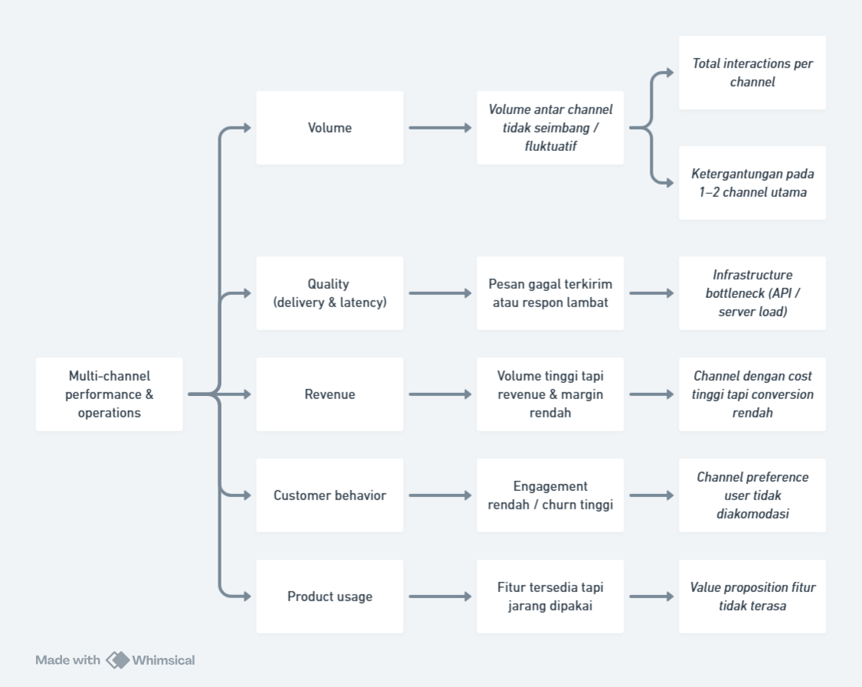
Root Cause Analysis
Disclaimer
"The data provided is a representation of the original data which amount has been adjusted. The data used is NOT representation of original data, adjusted for educational purposes and does not reflect the actual business condition of the company."

Slide 7
02
Analyst
Tools & Methods - Python & Tableau
Disclaimer
"The data provided is a representation of the original data which amount has been adjusted. The data used is NOT representation of original data, adjusted for educational purposes and does not reflect the actual business condition of the company."

Slide 8

WhatsApp drives volume, SMS drives revenue, enabling a balanced omnichannel strategy.

Slide 9
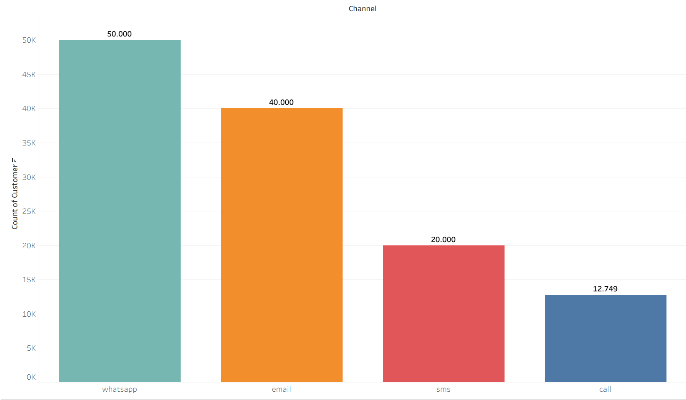
Volume Transaction
Total Channel Whatsapp 50.000 Transaction
Total Channel Email 40.000 Transaction
Total Channel SMS 20.000 Transaction
Total Channel Call 12.749 Transaction
Active Users: 20 Companies (100% Multi-channel).
WhatsApp dominates transaction volume, while all active companies consistently use multiple channels, indicating strong demand for omnichannel communication.
Total Volume 122749
Disclaimer
"The data provided is a representation of the original data which amount has been adjusted. The data used is NOT representation of original data, adjusted for educational purposes and does not reflect the actual business condition of the company."

Slide 10
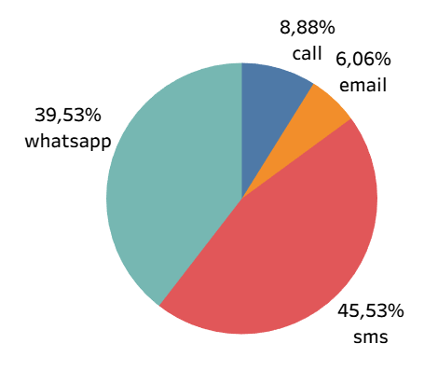
Revenue
SMS is Revenue King (Unexpected, but facts)
WhatsApp is High Volume but Mid Revenue
Email is Low Revenue Channel
Call is Niche Channel (Low Volume but Revenue oke)
Total All Revenue Rp. 25.946.420.
Revenue Concentration Risk, >85% of revenue comes from SMS + WhatsApp.
Total All Revenue
Rp. 25.946.420
Disclaimer
"The data provided is a representation of the original data which amount has been adjusted. The data used is NOT representation of original data, adjusted for educational purposes and does not reflect the actual business condition of the company."

Slide 11
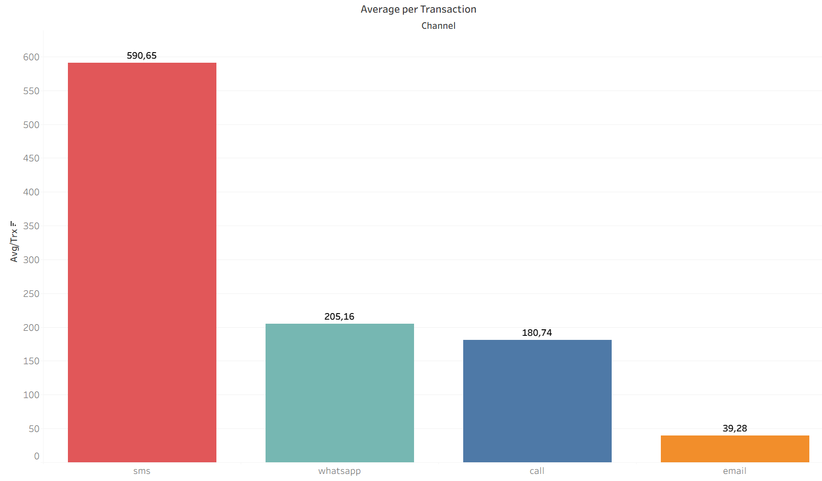
Average Per Transaction
SMS is a premium channel. Although the volume is not the largest, each transaction 2.5x of WhatsApp & 12x of email.
WhatsApp is a massive volume driver, but pricing/value per transaction is still moderate.
Email is a cheap channel. It's suitable for large scale, but it contributes almost nothing to revenue.
Calls are relatively expensive to operate. This channel is for specific cases, not mass usage.
SMS delivers the highest value per transaction, while WhatsApp drives volume with monetization potential. Email is a low-cost support channel, and Call serves high-touch use cases.
Disclaimer
"The data provided is a representation of the original data which amount has been adjusted. The data used is NOT representation of original data, adjusted for educational purposes and does not reflect the actual business condition of the company."

Slide 12

SMS for critical reliability, optimize WhatsApp and Email, limit Calls.

Slide 13
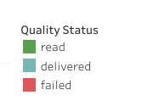
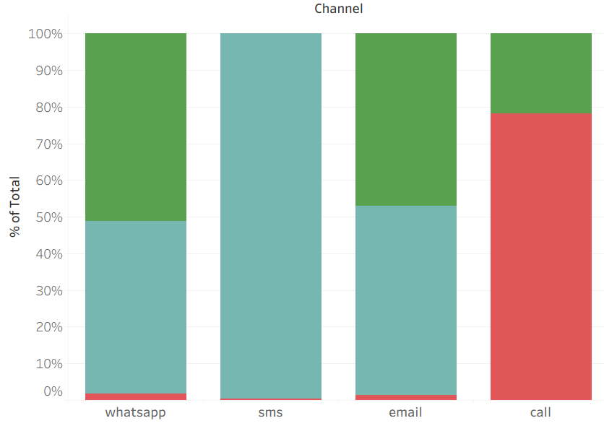
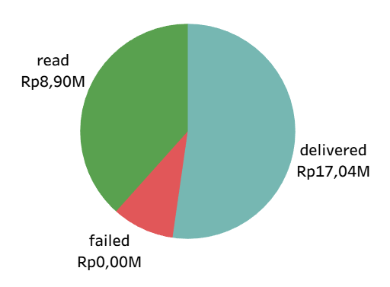
Quality of Service
SMS Is the Most Reliable and Effective Channel.
WhatsApp Performs Well but Suffers from Latency Issues.
Email Is Moderately Effective with Higher Pending Risk.
Call Channel Is Highly Ineffective Due to User Behavior
SMS is the most reliable channel, WhatsApp and Email show delivery delays, while Call is highly ineffective due to user non-response rather than technical failure.
Disclaimer
"The data provided is a representation of the original data which amount has been adjusted. The data used is NOT representation of original data, adjusted for educational purposes and does not reflect the actual business condition of the company."

Slide 14
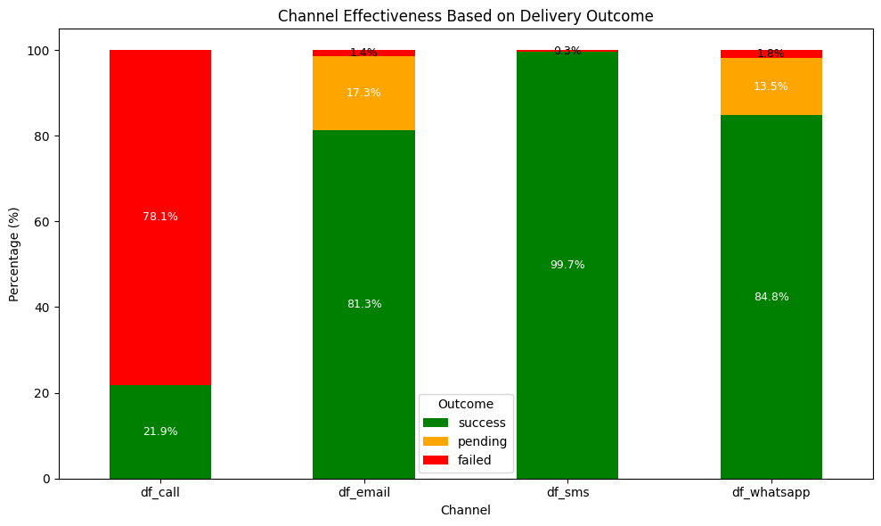
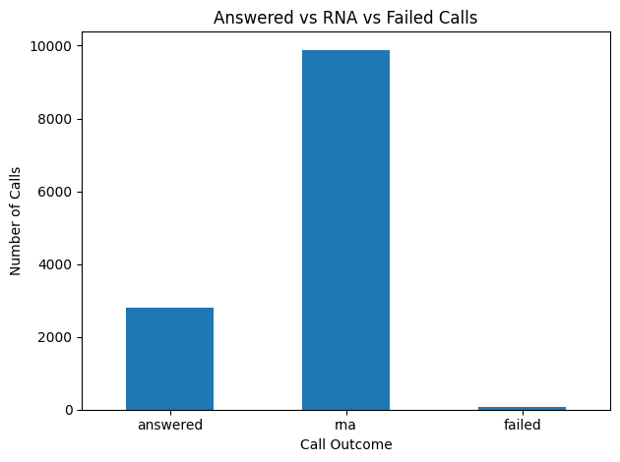
Quality of Service
Overall Delivery Effectiveness Is Strong, but Delays Remain a Concern
SMS is the most reliable channel. There are almost zero issues, making it suitable for critical communication.
The main problem with Whatsatpp & Email is not that it fails, but that it has a high pending rate.
Calls are not scalable and highly inefficient. The majority of calls are not connected, not due to technical issues, but rather user behavior (RNA).
Disclaimer
"The data provided is a representation of the original data which amount has been adjusted. The data used is NOT representation of original data, adjusted for educational purposes and does not reflect the actual business condition of the company."

Slide 15

Engagement stable, volume concentrated, email declining, WhatsApp drives upsell opportunities.

Slide 16
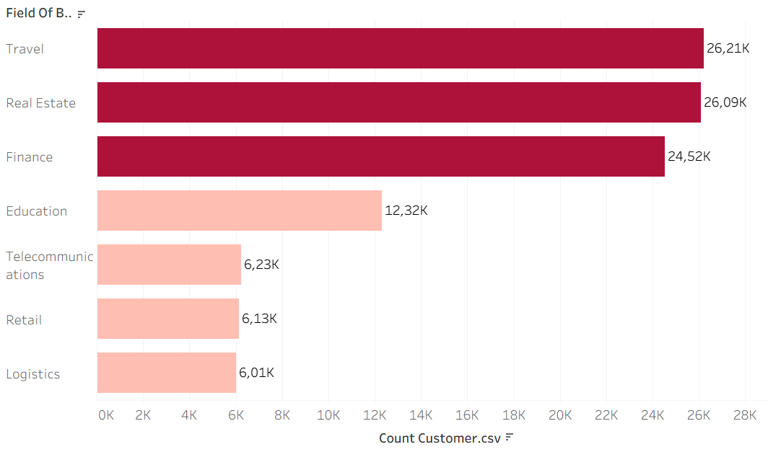
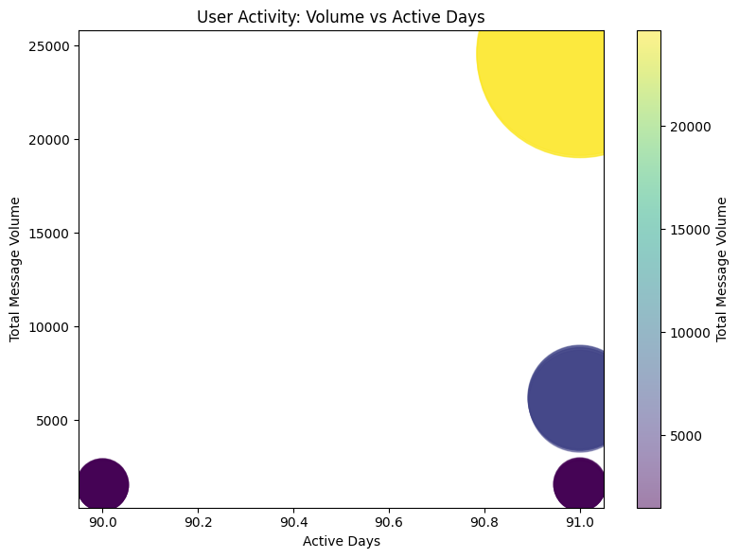
Top Users
Volume & Active Days
High Activity Does Not Always Mean High Volume.
Extreme Volume Concentration Among a Few Key Clients.
Industry Pattern: Volume-Driven vs Usage-Driven
Long-Tenured Clients Are Not Always Top Contributors
Top Users Are Very Active, but Volume Is Highly Concentrated 3 top users (Travel, Finance, Real Estate) around 24.5K
While most clients are consistently active, message volume is highly concentrated among a few key users, indicating dependency risk and strong upselling potential among highly engaged but low-volume clients.
Disclaimer
"The data provided is a representation of the original data which amount has been adjusted. The data used is NOT representation of original data, adjusted for educational purposes and does not reflect the actual business condition of the company."

Slide 17
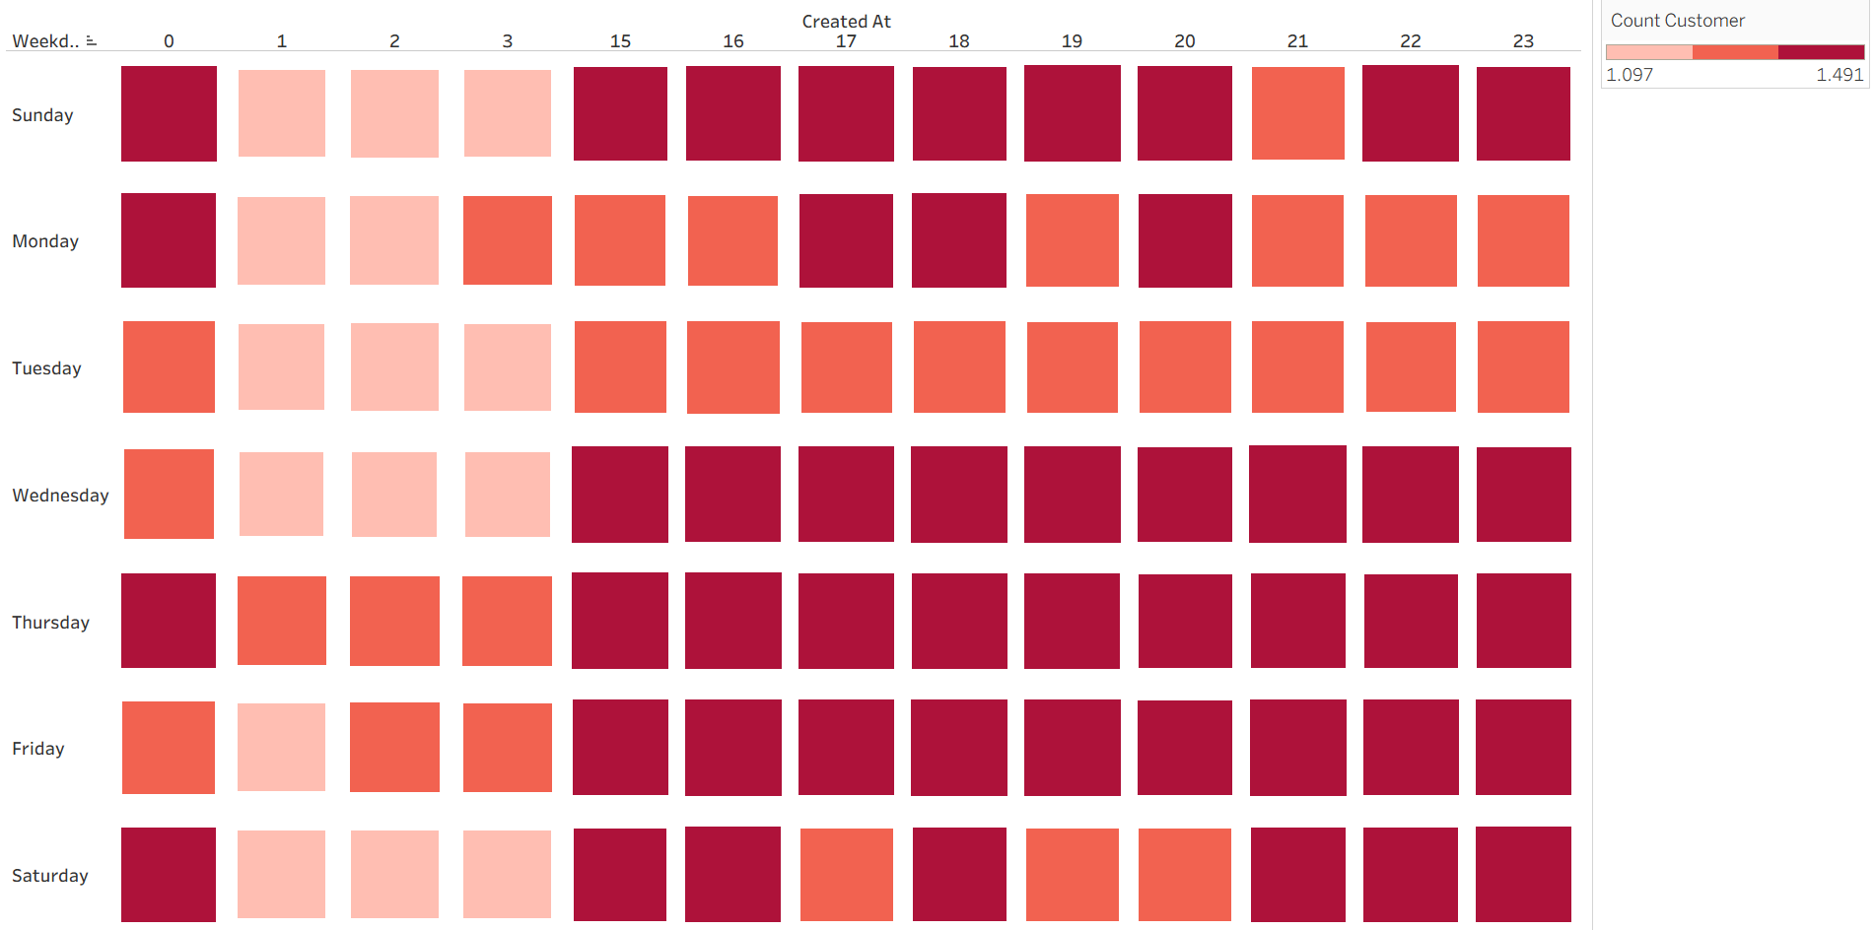
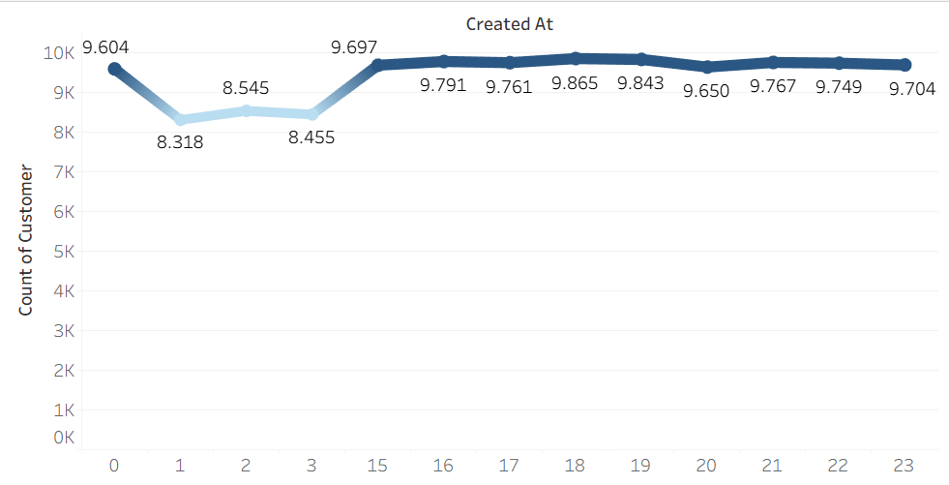
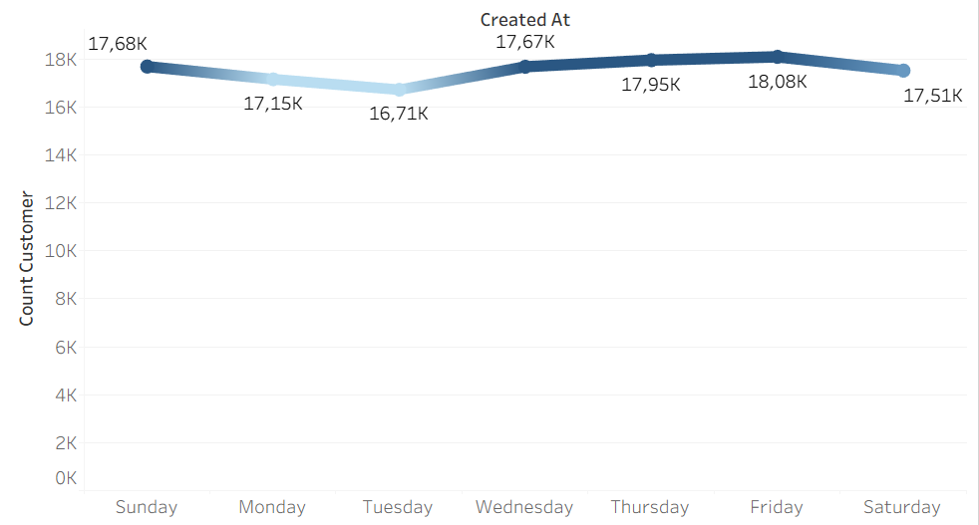
Traffic Users
Users are most responsive in the evening window, making it the optimal time for high-impact blast messages.
Consistent Engagement Throughout the Week.
Low Engagement During Early Morning Hours
User engagement peaks in the evening (15.00–23.00) and remains stable throughout the week, with the highest activity on Wednesday - Fridays, making evenings on weekdays the optimal window for blast messaging.
Disclaimer
"The data provided is a representation of the original data which amount has been adjusted. The data used is NOT representation of original data, adjusted for educational purposes and does not reflect the actual business condition of the company."

Slide 18
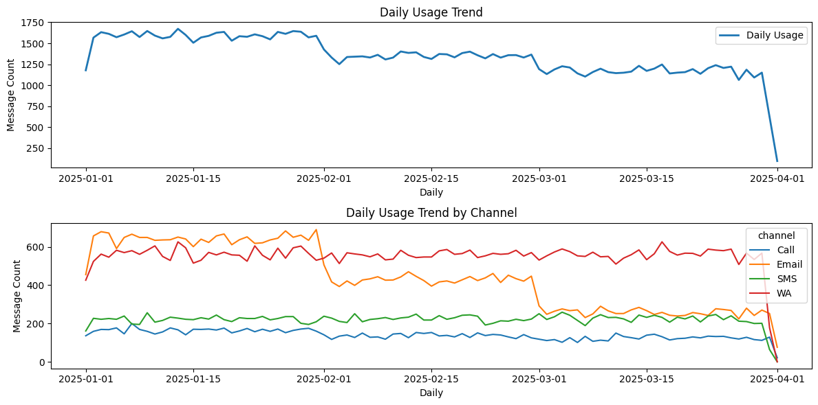
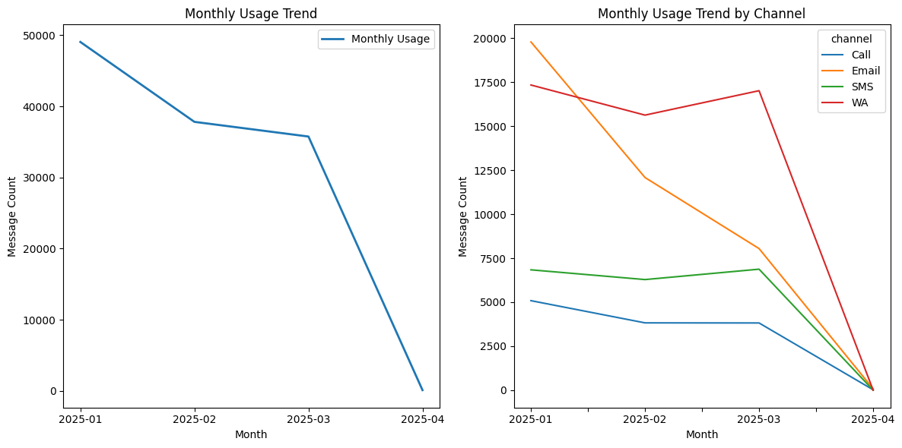
Trend Users
Daily Usage
Monthly Usage
The overall traffic decline is primarily driven by the decrease in Email usage, while the shift in user behavior toward WhatsApp highlights churn risk among Email-dependent clients and revenue opportunities through WhatsApp-focused engagement.
Disclaimer
"The data provided is a representation of the original data which amount has been adjusted. The data used is NOT representation of original data, adjusted for educational purposes and does not reflect the actual business condition of the company."

Slide 19
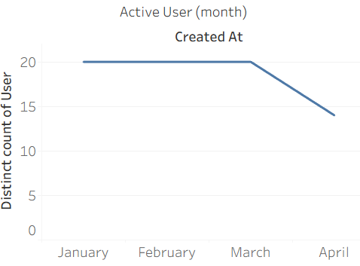
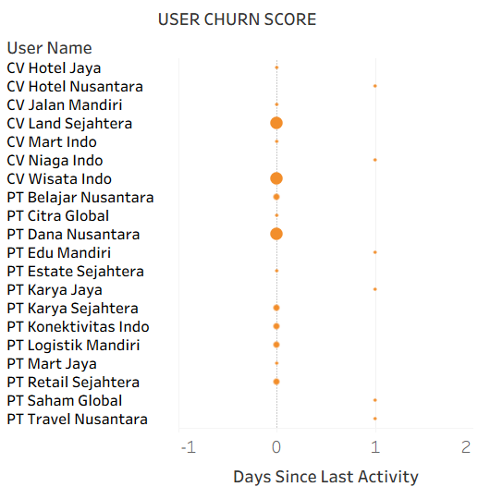
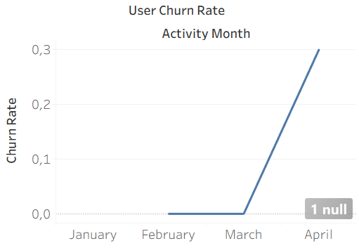
Customer Behavior
Top Users
Relatively Low Churn Risk for High-Volume & High-Engagement Users
Early Warning: Usage & Revenue Drop Begins to Appear
Upsell Opportunity pada High-Active, Low-Volume Users
Top users show strong engagement and low churn risk, but volume is highly concentrated among a few key accounts, highlighting dependency risk and significant upsell potential among consistently active yet low-volume clients.
Disclaimer
"The data provided is a representation of the original data which amount has been adjusted. The data used is NOT representation of original data, adjusted for educational purposes and does not reflect the actual business condition of the company."

Slide 20
Insight Summary
WhatsApp drives volume, SMS drives revenue, enabling a balanced omnichannel strategy.
SMS for critical reliability, optimize WhatsApp and Email, limit Calls.
Engagement stable, volume concentrated, email declining, WhatsApp drives upsell opportunities.

Slide 21



Recommendations
Reduce Dependency Risk through Volume Diversification
Action: Encourage increased volume from existing active but low-volume clients through bundling packages and usage incentives.
INCREASE REVENUE
RATE REVENUE
Rp. 1.667.700
6.91%
Disclaimer
"The data provided is a representation of the original data which amount has been adjusted. The data used is NOT representation of original data, adjusted for educational purposes and does not reflect the actual business condition of the company."

Slide 22

Recommendations
Shift Revenue Growth to WhatsApp-Centric Strategy
Action: Focus on WhatsApp as the primary channel for upsells, automation, and value-added services.
GROWTH REVENUE
Whatsapp
55.2%
Email
-5%
SMS
-5%
CALL
-5%
Disclaimer
"The data provided is a representation of the original data which amount has been adjusted. The data used is NOT representation of original data, adjusted for educational purposes and does not reflect the actual business condition of the company."

Slide 23
Recommendations
Protect SMS as Critical Revenue Backbone
Action: Maintain the quality, pricing power, and positioning of SMS as a critical channel, not a mass blast.
INCREASE REVENUE
RATE REVENUE
Rp. 307.138
2.6%
Disclaimer
"The data provided is a representation of the original data which amount has been adjusted. The data used is NOT representation of original data, adjusted for educational purposes and does not reflect the actual business condition of the company."

Slide 24
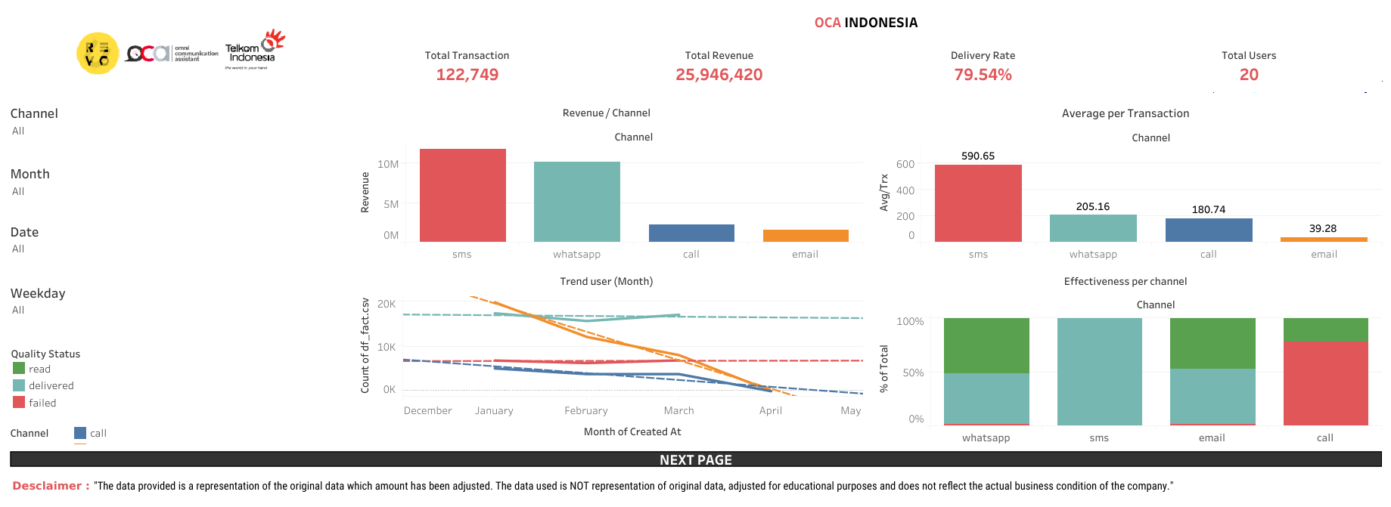
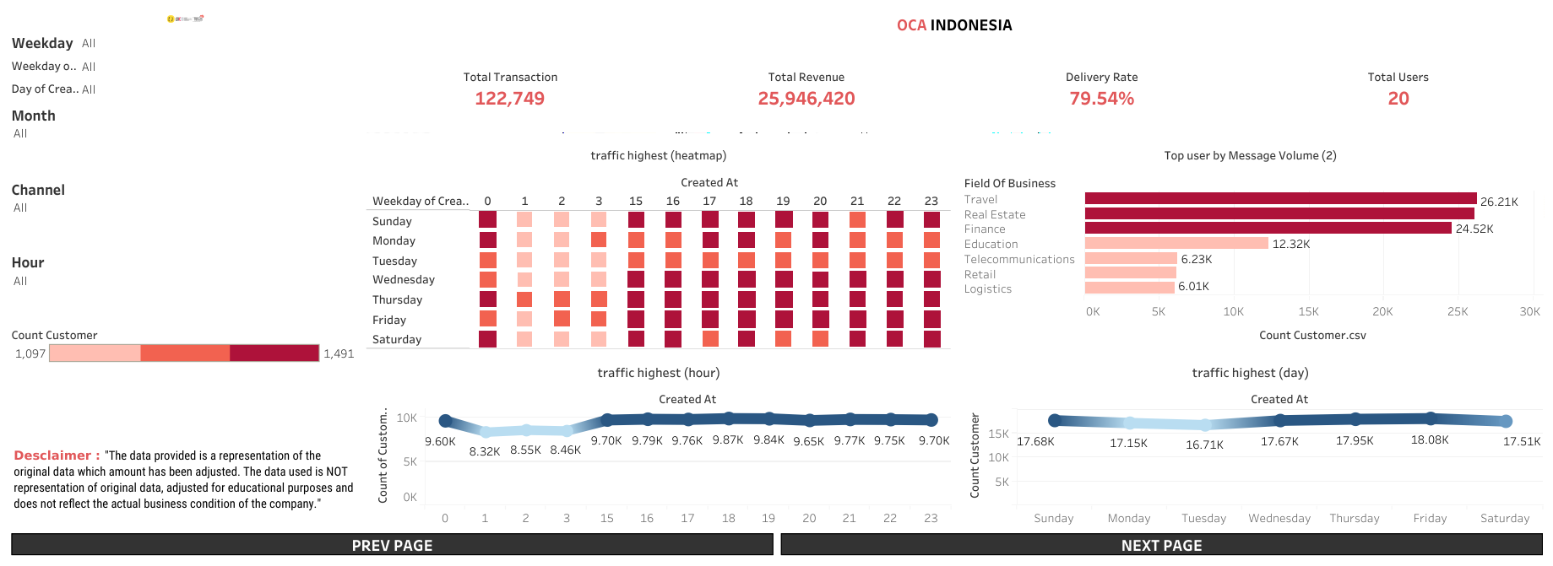
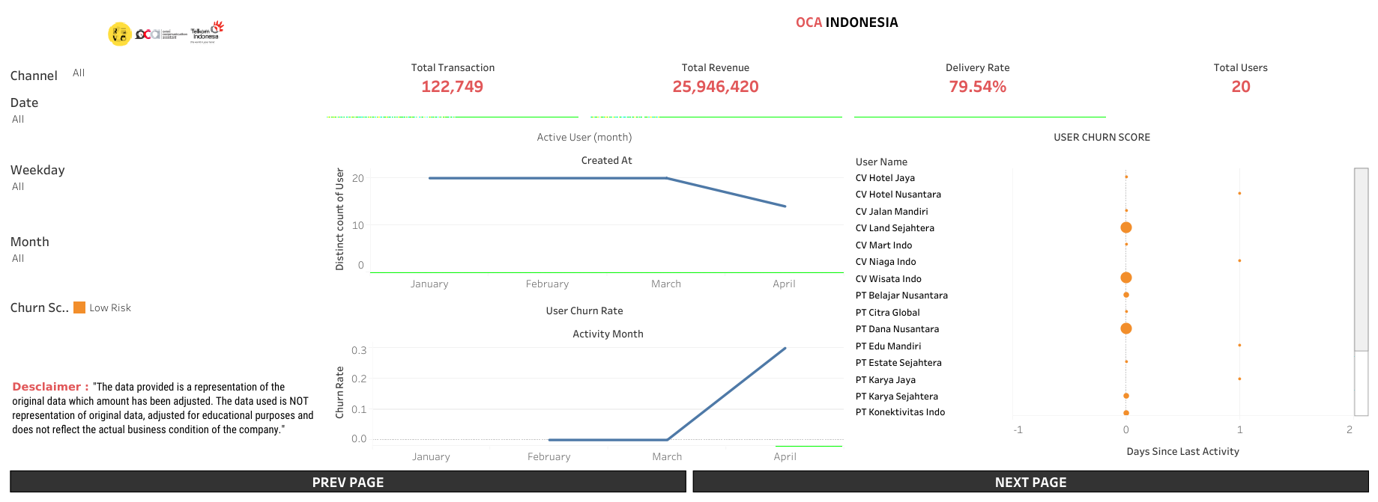
Dashboard
Disclaimer
"The data provided is a representation of the original data which amount has been adjusted. The data used is NOT representation of original data, adjusted for educational purposes and does not reflect the actual business condition of the company."

Slide 25


Thanks!
Do you have any questions?
mikhaelput@gmail.com
Code Python
Linkedin

Slide 26
Appendix.

Slide 27

Video
Presentation

Slide 28
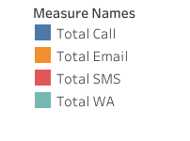
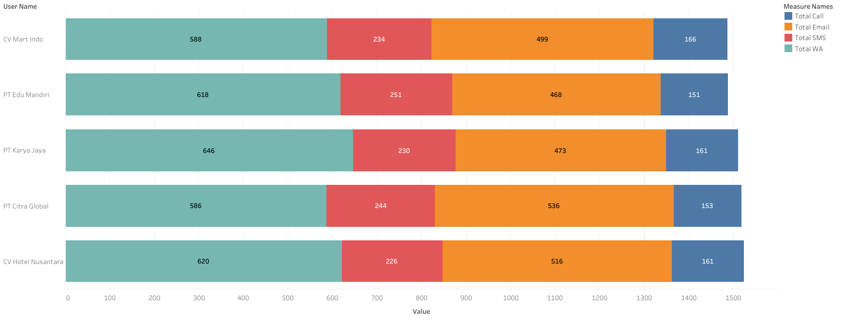
Product usage
Bottom Users
SMS is the most reliable channel. There are almost zero issues, making it suitable for critical communication.
The main problem with Whatsatpp & Email is not that it fails, but that it has a high pending rate.
Calls are not scalable and highly inefficient. The majority of calls are not connected, not due to technical issues, but rather user behavior (RNA).
SMS is the most reliable channel, WhatsApp and Email show delivery delays, while Call is highly ineffective due to user non-response rather than technical failure.
Disclaimer
"The data provided is a representation of the original data which amount has been adjusted. The data used is NOT representation of original data, adjusted for educational purposes and does not reflect the actual business condition of the company."

Slide 29

Recomendation
Sales & Account Management
Action: Conduct a Business Review with the Top 3 Clients to address the decline in March volume. Offer a “Q2 Kick-off” promotional package.
Goal: Restore the volume trend to 45k+ per month.
Disclaimer
"The data provided is a representation of the original data which amount has been adjusted. The data used is NOT representation of original data, adjusted for educational purposes and does not reflect the actual business condition of the company."

Slide 30
Recomendation
Product & Tech (CTO)
Action: Audit Voice Call routes and rotate sender numbers (Number Masking) to avoid spam labels.
Goal: Increase Voice Call Success Rate to at least 60%.
Disclaimer
"The data provided is a representation of the original data which amount has been adjusted. The data used is NOT representation of original data, adjusted for educational purposes and does not reflect the actual business condition of the company."

Slide 31
Recomendation
Operations
Action: Implement the “Smart Queue” feature or low-cost incentives for deliveries outside of peak hours (afternoon/evening).
Goal: Even out server load (Load Balancing).
Disclaimer
"The data provided is a representation of the original data which amount has been adjusted. The data used is NOT representation of original data, adjusted for educational purposes and does not reflect the actual business condition of the company."

Slide 32
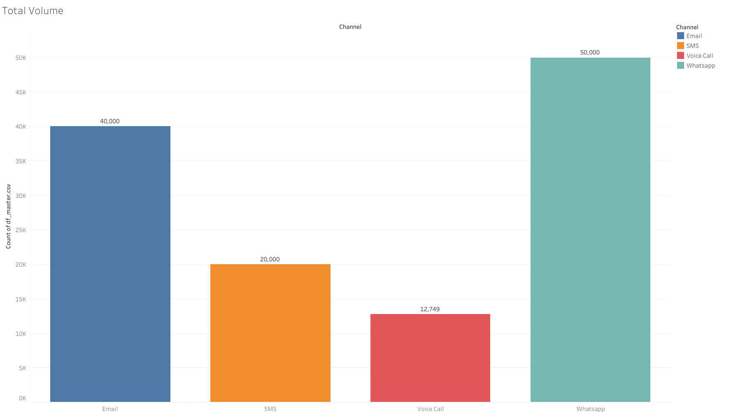
Revenue & Volume Breakdown
Cash Cows: WhatsApp (~11.9M) and SMS (~11.8M) contribute ~91% of total revenue.
High Volume, Low Value: Email has high volume (40k messages) but minimal revenue contribution (~1.5M) due to low price per unit.
Revenue dependence on WhatsApp and SMS is very high. Regulatory changes to pricing on these two platforms will have a direct impact on the company's bottom line.
Disclaimer
"The data provided is a representation of the original data which amount has been adjusted. The data used is NOT representation of original data, adjusted for educational purposes and does not reflect the actual business condition of the company."

Slide 33
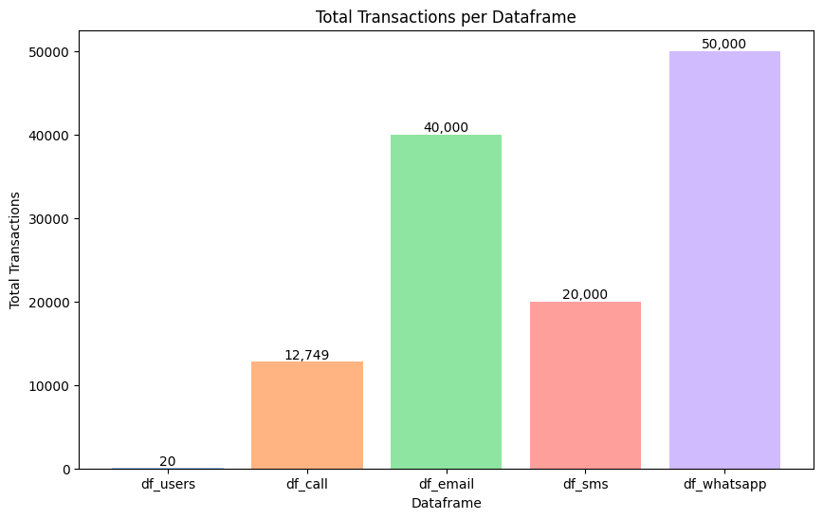




Executive Summary
Total Revenue (Est): IDR 26.0 Million (Dominated by WA & SMS).
Total Volume: 122,749 Messages.
Success Rate: 71.3% (Average of all channels).
Active Clients: 20 Companies (100% Multi-channel).
20.000
40.000
In terms of revenue, we are very strong in WhatsApp & SMS. However, there are significant operational risks in Voice Call services (low success rate) and business risks in the declining volume trend in March.
20 Users
12749
50.000
Disclaimer
"The data provided is a representation of the original data which amount has been adjusted. The data used is NOT representation of original data, adjusted for educational purposes and does not reflect the actual business condition of the company."

Slide 34
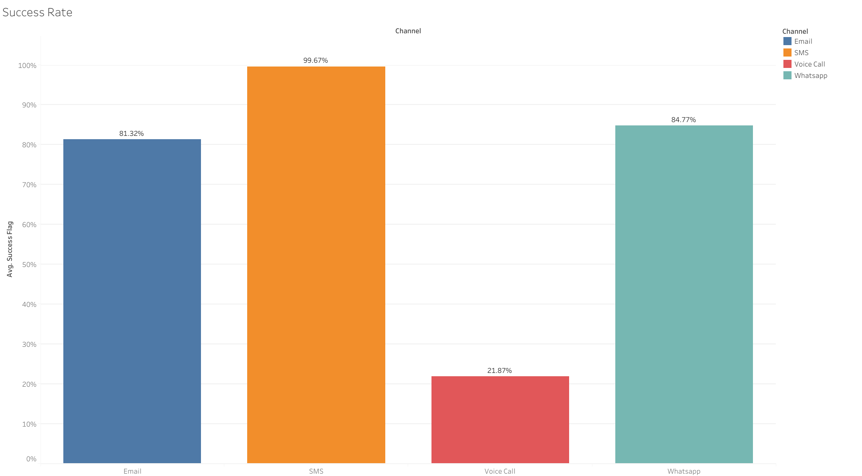
Operational Health
Top Performer: SMS ranks first with a 99.6% success rate. Very stable.
Standard: WhatsApp (84%) & Email (81%) are at a reasonable level.
Critical Issue: Voice Call only has a 21.8% success rate. This means that out of 5 calls, 4 fail/are not answered.
Voice Call service has the worst performance. This has the potential to waste server resources and reduce client trust.
Disclaimer
"The data provided is a representation of the original data which amount has been adjusted. The data used is NOT representation of original data, adjusted for educational purposes and does not reflect the actual business condition of the company."

Slide 35
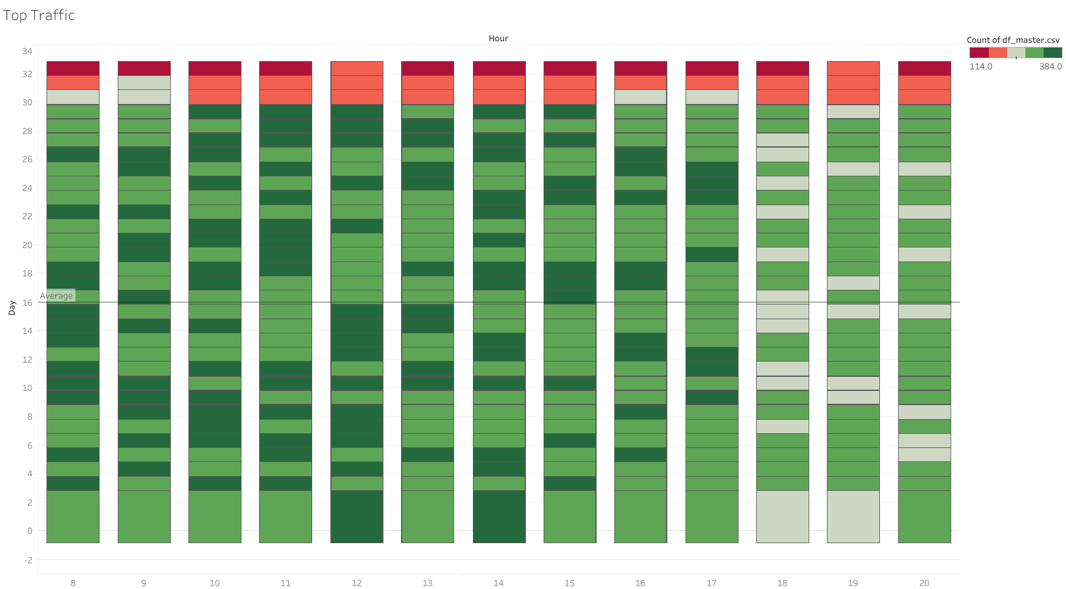
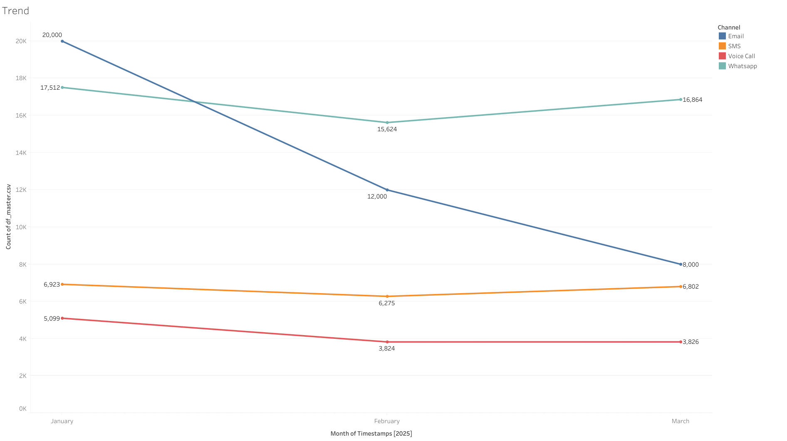
Trend & Time Analysis
Alert (Decreasing Trend): Volume decreased by 28% from January (49k) to March (35k).
Peak Hours: Traffic peaked between 9:00 a.m. and 12:00 p.m.
There has been a significant decline in usage after January (possibly due to seasonal effects). Operationally, servers must be ready to accommodate the ‘Morning Blast’ load spike between 9:00 a.m. and 12:00 p.m
Disclaimer
"The data provided is a representation of the original data which amount has been adjusted. The data used is NOT representation of original data, adjusted for educational purposes and does not reflect the actual business condition of the company."

Slide 36
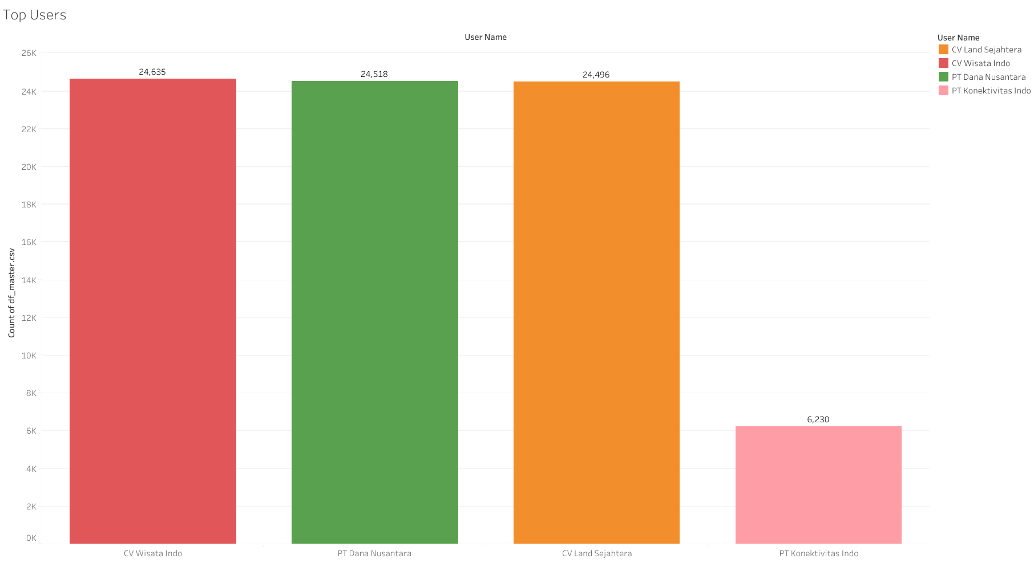
Customer Portfolio (Top User)
Top 3 Clients: CV Wisata Indo (Travel), PT Dana Nusantara (Finance), CV Land Sejahtera (Property/General)
These three clients have nearly identical volumes (~24k messages).
All 20 current active users are Multi-channel Users (using all channels). This is a sign of good product stickiness, but the risk of churn becomes fatal if one client leaves.
Disclaimer
"The data provided is a representation of the original data which amount has been adjusted. The data used is NOT representation of original data, adjusted for educational purposes and does not reflect the actual business condition of the company."

Slide 37
01
About OCA Indonesia
Communication Platform-as-a-Service (CPaaS)
Disclaimer
"The data provided is a representation of the original data which amount has been adjusted. The data used is NOT representation of original data, adjusted for educational purposes and does not reflect the actual business condition of the company."

Slide 38
Business Problem
Objective
OCA Indonesia has difficulty comparing channel performance and understanding user behavior due to fragmented data. Therefore, a consolidated report is needed that integrates multichannel data, standardizes key metrics, and analyzes user behavior to provide quick visibility into performance, user habits, and operational efficiency to support decision making.
To provide a consolidated analytical report that enables OCA Indonesia to :
Compare performance across multiple communication channels.
Understand user behavior and interaction patterns.
Support operational monitoring and strategic business decision-making
Disclaimer
"The data provided is a representation of the original data which amount has been adjusted. The data used is NOT representation of original data, adjusted for educational purposes and does not reflect the actual business condition of the company."

Slide 39
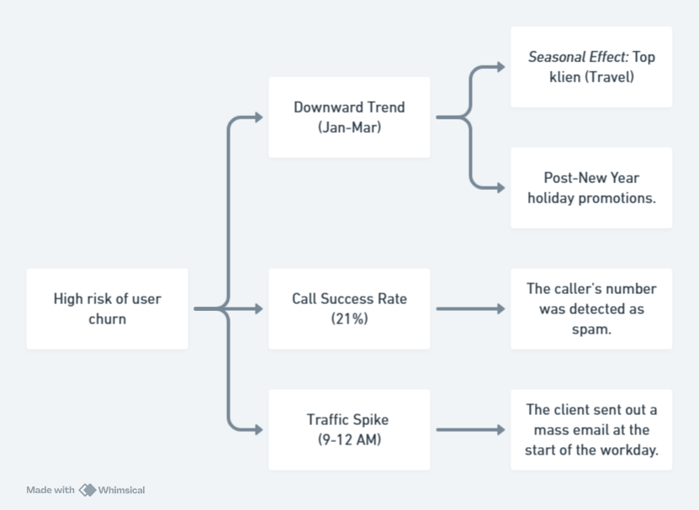
Root Cause Analysis
Disclaimer
"The data provided is a representation of the original data which amount has been adjusted. The data used is NOT representation of original data, adjusted for educational purposes and does not reflect the actual business condition of the company."

Slide 40


